Slide 1
Module 12: IPS Operation and Implementation
Networking Security v1.0
(NETSEC)
Notes:
Networking Security (NETSEC) Module 12: IPS Operation and Implementation

Slide 2
Module Objectives
Module Title: IPS Operation and Implementation
Module Objective: Explain how signatures are used to detect malicious network traffic.
Topic Title | Topic Objective
IPS Signatures | Describe IPS signatures.
Cisco Snort IPS | Explain how the Cisco Snort IPS provides network security services.
Configure Snort IPS | Explain how to configure Snort IPS on a Cisco ISR G2.
Notes:
2
12 – IPS Operation and Implementation
12.0.2 – What will I learn in this module?

Slide 3
12.1 IPS Signatures
Notes:
12: IPS Operation and Implementation 12.1: IPS Signatures

Slide 4
IPS Signatures
IPS Signature Attributes
The network must be able to identify incoming malicious traffic in order to stop it. Fortunately, malicious traffic displays distinct characteristics or “signatures”. Signatures uniquely identify specific viruses, worms, protocol anomalies, and malicious traffic.
PS sensors must be tuned to look for matching signatures or abnormal traffic patterns. As sensors scan network packets, they use signatures to detect known attacks and respond with predefined actions. An IDS or IPS sensor examines the data flow using many different signatures.
Signatures have three distinctive attributes:
Type - Atomic or Composite
Trigger - Also called the alarm
Action - What the IPS will do
Notes:
12: IPS Operation and Implementation 12.1: IPS Signatures 12.1.1: IPS Signature Attributes

Slide 5
IPS Signatures
Types of Signatures
Some threats can be identified in one packet while other threats may require many packets and their state information (i.e., IP addresses, port numbers, and more) to identify a threat.
There are two types of signatures:
Atomic Signature - This is the simplest type of signature because a single packet, activity, or event identifies an attack. The IPS does not need to maintain state information and traffic analysis can usually be performed very quickly and efficiently.
Composite Signature - Also called a stateful signature because the IPS requires several pieces of data to match an attack signature. The IPS must also maintain state information which is referred to as the event horizon. The length of an event horizon varies from one signature to the next.
The heart of any IPS signature is the signature alarm, which is often referred to as the signature trigger.
Notes:
12: IPS Operation and Implementation 12.1: IPS Signatures 12.1.2: Types of Signatures

Slide 6
IPS Signatures
IPS Signature Alarms
Every IPS incorporates signatures that use one or more of these basic triggering mechanisms to trigger signature actions. There are four general IPS signature trigger categories as listed in the table.
Detection Type | Advantages
Pattern-Based Detection | Also known as signature-based detection. Simplest triggering mechanism as it searches for a specific and pre-defined atomic or composite pattern. A IPS sensor compares the network traffic to a database of known attacks, and triggers an alarm or prevents communication if a match is found.
Anomaly-Based Detection | Also known as profile-based detection. Involves first defining a profile of what is considered normal network or host activity. This normal profile is usually defined by monitoring traffic and establishing a baseline. Once defined, any activity beyond a specified threshold in the normal profile will generate a signature trigger and action.
Policy-Based Detection | Also known as behavior-based detection. Although similar to pattern-based detection, an administrator manually defines behaviors that are suspicious based on historical analysis. The use of behaviors enables a single signature to cover an entire class of activities without having to specify each individual situation.
Honey Pot-Based Detection | Honey pot-based detection uses a server as a decoy server to attract attacks. The purpose of a decoy server is to lure attacks away from production devices. Allows administrators time to analyze incoming attacks and malicious traffic patterns to tune their sensor signatures.
Notes:
12: IPS Operation and Implementation 12.1: IPS Signatures 12.1.3: IPS Signature Alarms

Slide 7
IPS Signatures
IPS Signature Actions
Alert Category | Specific Action | Description
Generate an alert | Produce alert | The IPS sends events as alerts.
Generate an alert | Produce verbose alert | The IPS sends a detailed event alert.
Log the activity | Log attacker packets | Logs packets from the attacker IP address and sends an alert.
Log the activity | Log pair packets | Logs packets from the victim and attacker IP addresses and sends an alert.
Log the activity | Log victim packets | Logs packets from the victim IP address and sends an alert.
Deny the activity | Deny attacker inline | Terminates the current packet and future packets from this attacker address for a specified period of time.
Deny the activity | Deny connection inline | Logs packets from the victim IP address and sends an alert.
Deny the activity | Deny packet inline | Terminates the current packet and future packets from this attacker address for a specified period of time.
Notes:
12: IPS Operation and Implementation 12.1: IPS Signatures 12.1.4: IPS Signature Actions

Slide 8
IPS Signatures
IPS Signature Actions (Cont.)
Alert Category | Specific Action | Description
Reset the TCP connection | Reset TCP connection | Sends TCP resets to hijack and terminate the TCP flow.
Block future activity | Request block connection | Sends a request to a blocking device to block this connection.
Block future activity | Request block host | Sends a request to a blocking device to block this attacker host.
Block future activity | Request SNMP trap | Sends a request to the notification application component of the sensor to perform SNMP notification.

Slide 9
IPS Signatures
Evaluating Alerts
The table summarizes the following four types of alarms.
Alarm Type | Network Activity | IPS Activity | Outcome
True positive | Attack traffic | Alarm generated | Ideal setting
True negative | Normal user traffic | No alarm generated | Ideal setting
False positive | Normal user traffic | Alarm generated | Tune alarm
False negative | Attack traffic | No alarm generated | Tune alarm
Notes:
12: IPS Operation and Implementation 12.1: IPS Signatures 12.1.5: Evaluating Alerts

Slide 10
IPS Signatures
Evaluating Alerts (Cont.)
Alerts can be classified as follows:
True positive - (Desirable) This is used when the IPS generates an alarm because it detected know attack traffic. The alert has been verified to be an actual security incident and also indicates that the IPS rule worked correctly.
True negative - (Desirable) This is used when normal network traffic does not generate an alarm. No alerts are issued because the traffic that is passing through the system is clear of threats.
False positive - (Undesirable) This is used when an IPS generates an alarm after processing normal user traffic that should not have triggered an alarm. The IPS must be tuned to change these alarm types to true negatives. The alert does not indicate an actual security incident. Benign activity that results in a false positive is sometimes referred to as a benign trigger. False positives are costly because they must be investigated.
False negative - (Dangerous) This is used when an IPS fails to generate an alarm and known attacks are not being detected. This means that exploits are not being detected by the security systems that are in place. These incidents could go undetected for a long time, and ongoing data loss and damage could result. The goal is for these alarm types to generate true positive alarms.
Notes:
12: IPS Operation and Implementation 12.1: IPS Signatures 12.1.5: Evaluating Alerts
12.1.6: Check Your Understanding – IPS Signature Actions

Slide 11
12.2 Cisco Snort IPS
Notes:
12: IPS Operation and Implementation 12.2: Cisco Snort IPS

Slide 12
Cisco Snort IPS
Cisco IPS
Organizations now have three options available to provide intrusion prevention services.
Cisco Firepower Next-Generation IPS (NGIPS) - These are dedicated in-line threat prevention appliances that provide industry leading effectiveness against both known and unknown threats.
Cisco Snort IPS - This is an IPS service that can be enabled on a second generation ISR (ISR G2) (i.e., ISR 4000s). Note that Cisco 4000 ISRs no longer support Cisco IOS IPS.
External Snort IPS Server - This is similar to the Cisco Snort IPS solution but requires a promiscuous (i.e., a SPAN switch port) port and an external Snort IDS/IPS.
Notes:
12: IPS Operation and Implementation 12.2: Cisco Snort IPS 12.2.1: Cisco IPS

Slide 13
Cisco Snort IPS
NGIPS
NGIPS are dedicated IPS appliances. They are built on the core open technology of Snort and use vulnerability-focused IPS rules and embedded IP-, URL-, and DNS-based security intelligence that is provided by Cisco’s Talos Security Intelligence and Research Group.
NGIPS features include:
IPS rules that identify and block attack traffic that target network vulnerabilities
Tightly integrated defense against advanced malware incorporating advanced analysis of network and endpoint activity
Sandboxing technology that uses hundreds of behavioral indicators to identify zero-day and evasive attacks
Also includes Application Visibility and Control (AVC), Cisco Advanced Malware Protection (AMP) for Networks, and URL Filtering
Notes:
12: IPS Operation and Implementation 12.2: Cisco Snort IPS 12.2.2: NGIPS

Slide 14
Cisco Snort IPS
Snort IPS
Snort is an open source network IPS that performs real-time traffic analysis and generates alerts when threats are detected on IP networks. It can also perform protocol analysis, content searching or matching, and detect a variety of attacks and probes, such as buffer overflows, stealth port scans, and so on.
Snort IPS on the 4000 Series ISR provides the following functionalities:
Intrusion detection system (IDS) and IPS mode
Three signature levels
An allowed list
Snort health monitoring
Fail open and close
Signature update
Event logging
Notes:
12: IPS Operation and Implementation 12.2: Cisco Snort IPS 12.2.3: Snort IPS

Slide 15
Cisco Snort IPS
Snort Components and Rules
Snort IPS for 4000 Series ISRs consists of two components:
Snort engine - This is the IPS detection and enforcement engine that is included in the SEC license for 4000 Series ISRs.
Snort rule software subscriptions for signature updates - Snort rule sets to keep current with the latest threat protection are term-based subscriptions, available for one or three years.
To address the rapidly evolving threat landscape, it is important to ensure that signatures are as up-to-date as possible.
There are two types of term-based subscriptions:
Community Rule Set - Available for free, the rules that are provided offer limited coverage against threats. The community rule set focuses on reactive response to security threats versus proactive research work. There is also a 30-day delayed access to updated signatures meaning that newest rule will be a minimum of 30 days old. In addition, there is no Cisco customer support available.
Subscriber Rule Set - Available for a fee, this service provides the best protection against threats. It includes coverage of advance of exploits by using the research work of the Cisco Talos security experts. The Subscriber Rule Set also provides the fastest access to updated signatures in response to a security incident or the proactive discovery of a new threat. This subscription is fully supported by Cisco.
Notes:
12: IPS Operation and Implementation 12.2: Cisco Snort IPS 12.2.4: Snort Components and Rules

Slide 16
Cisco Snort IPS
ISR Container Applications
Routers were initially packet processing devices. Routers have acquired so much processing power that server applications can now be hosted inside the router using service containers.
Service containers are virtual machines that run on the routers. Applications such as Snort IPS can be uploaded and hosted on these routers. Service containers are supported on most IOS XE platforms. IOS XE is based on the Linux architecture and supports virtual machine hosting.
The Snort engine runs as a Linux Service Container application on the ISR 4000. This provides it with dedicated computing resources that run independently of the data plane CPU load. It also makes it easier for the Snort engine to be regularly updated.
Notes:
12: IPS Operation and Implementation 12.2: Cisco Snort IPS 12.2.5: ISR Container Applications

Slide 17
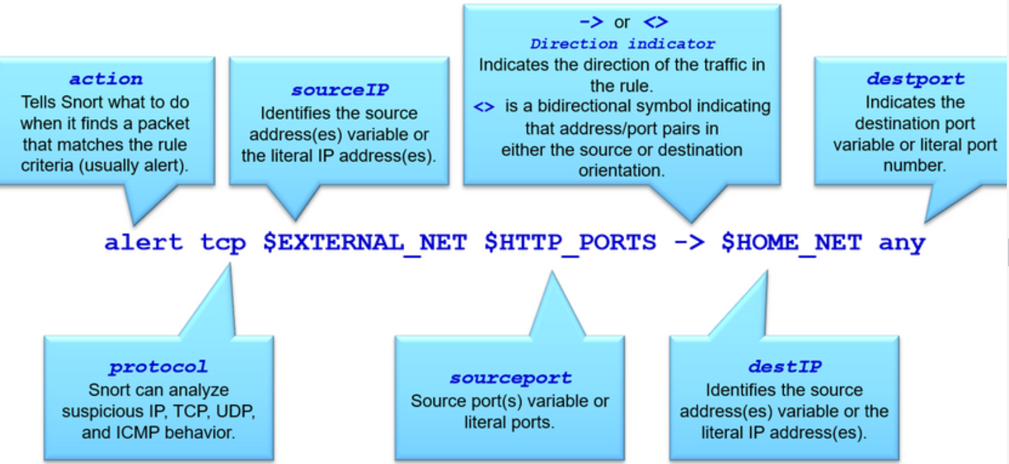
Cisco Snort IPS
Snort IPS Rule Alarms
In Snort IPS, signatures are configured using “rules”. These rules serve as the signature alarms by comparing incoming traffic to the Snort rules. Traffic matching a rule header generates an action. A rule header is conceptually similar to an access control list (ACL) statement (i.e., ACE). It is a one line statement that identifies malicious traffic.
The basic rule header command syntax is:
[action] [protocol] [sourceIP] [sourceport] -> [destIP] [destport] ([Rule options])
Refer to the figure for more information regarding the rule header command syntax.
Notes:
12: IPS Operation and Implementation 12.2: Cisco Snort IPS 12.2.6: Snort IPS Rule Alarms

Slide 18
Cisco Snort IPS
Snort IPS Rule Actions
Snort can be enabled in IDS mode or in IPS mode.
Snort IDS mode can perform the following three actions:
Alert - Generate an alert using the selected alert method, and then log the packet.
Log - Log the packet.
Pass - Ignore the packet.
Snort IPS mode can perform all of the IDS actions plus the following:
Drop - Block and log the packet.
Reject - Block the packet, log it, and then send a TCP reset if the protocol is TCP or an ICMP port unreachable message if the protocol is UDP.
Sdrop - Block the packet but do not log it.
Notes:
12: IPS Operation and Implementation 12.2: Cisco Snort IPS 12.2.7: Snort IPS Rule Actions

Slide 19
Cisco Snort IPS
Snort IPS Header Rule Options
A Snort rule header also contains rule options (fields) to provide additional information for the rule. Options are separated by semicolons (;) and the rule option keywords are separated from their arguments using colons (:).
The table describes the common general rule and the detection rule options in the sample rule header.
Rule Option | Specific Action
msg: | This is a simple text string that provides a meaningful message to output when the rule matches.
flow: | Specifies the direction of network traffic.
content: | A detection rule option that allows the user to set rules that search for specific content in the packet payload and trigger response based on that data. The option data can contain mixed text and binary data
distance: / offset: | Detection rule keywords that allow the rule writer to specify where to start searching relative to the beginning of the payload or the beginning of a content match.
within: / depth: | Detection rule keywords that allow the rule write to specify how far forward to search relative to the end of a previous content match and, once that content match is found, how far to search for it.
pcre | A detection rule keyword that allows rules to be written using “perl compatible regular expressions” which allows for more complex matches.
Notes:
12: IPS Operation and Implementation 12.2: Cisco Snort IPS 12.2.8: Snort IPS Header Rule Options

Slide 20
Cisco Snort IPS
Snort IPS Header Rule Options (Cont.)
The table describes the common general rule and the detection rule options in the sample rule header.
Rule Option | Specific Action
byte_test | A detection rule keyword that allows a rule to test a number of bytes against a specific value in binary.
metadata: | Allows a rule writer to embed additional information about the rule.
reference: | Allows rules to include references to external sources of information.
classtype: | Identifies the potential effect of what a successful attack would be.
sid / rev | The sid is a unique identifier for each rule making them easy to identify. It should be used with the rev (revision) keyword.
Notes:
12: IPS Operation and Implementation 12.2: Cisco Snort IPS 12.2.8: Snort IPS Header Rule Options

Slide 21
Cisco Snort IPS
Snort IPS Operation
Packets arriving on Snort enabled interfaces are inspected as follows:
Cisco IOS Software forwards the packets to be inspected to the Snort IPS engine using an internal virtual port group (VPG) interface.
Snort IPS inspects the traffic and takes necessary action.
Snort drops the packets associated with bad flows (IPS mode). Good flow packets are returned back to the router for further processing.
Packet exchange between the container applications and the IOS data plane is done using VPG interfaces. These routed interfaces are connected through the router back plane. The corresponding interface on the container side will appear as virtual Ethernet ports.
Notes:
12: IPS Operation and Implementation 12.2: Cisco Snort IPS 12.2.9: Snort IPS Operation

Slide 22
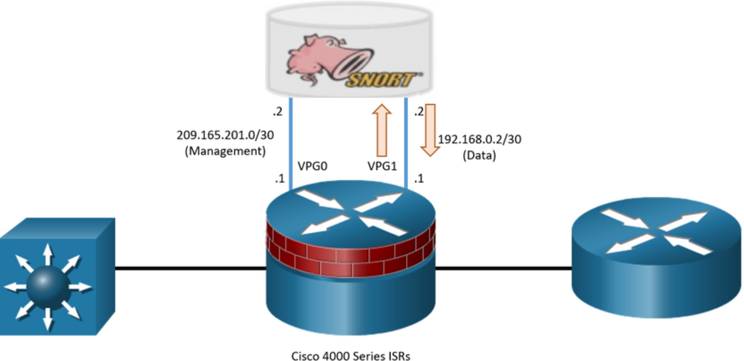
Cisco Snort IPS
Snort IPS Operation
Snort IPS requires two VPG interfaces:
Management interface - This is the interface that is used to source logs to the log collector and for retrieving signature updates from Cisco.com. For this reason, this interface requires a routable IP address.
Data interface - This is the interface that is used to send user traffic between the Snort virtual container service and the router forwarding plane.
In the figure, VPG0 is used for Snort management traffic while VPG1 is used for user traffic to be inspected. User traffic to be inspected is forwarded to the Snort engine using VPG1 as shown. Traffic is then inspected and either rejected (dropped) or forwarded back to the router.
Notes:
12: IPS Operation and Implementation 12.2: Cisco Snort IPS 12.2.9: Snort IPS Operation
12.2.10: Check Your Understanding - Snort IPS

Slide 23
12.3 Configure Snort IPS
Notes:
12: IPS Operation and Implementation 12.3: Configure Snort IPS

Slide 24
Configure Snort IPS
Snort IPS Configuration Steps
To deploy Snort IPS on supported devices, perform the following tasks:
Download the Snort OVA file.
Install the OVA file.
Configure VirtualPortGroup interfaces.
Activate the virtual services.
Configure Snort specifics (e.g., IPS or IDS mode, policy, reporting of events to an external alert/log server or IOS syslog or both, and the Signature update method.
Enable IPS globally or on desired interfaces.
Verify Snort.
Notes:
12: IPS Operation and Implementation 12.3: Configure Snort IPS 12.3.1: Snort IPS Configuration Steps

Slide 25
Configure Snort IPS
Step 1. Download the Snort OVA File
An Open Virtualization Archive (OVA) is a file that contains a compressed, installable version of a virtual machine.
The service OVA file is not bundled with the Cisco IOS XE Release images installed on the router. although the OVA files may be preinstalled in the flash of the router, it is recommended that the latest OVA file be downloaded from Cisco.com.
Notes:
12: IPS Operation and Implementation 12.3: Configure Snort IPS 12.3.2: Download the Snort OVA File

Slide 26
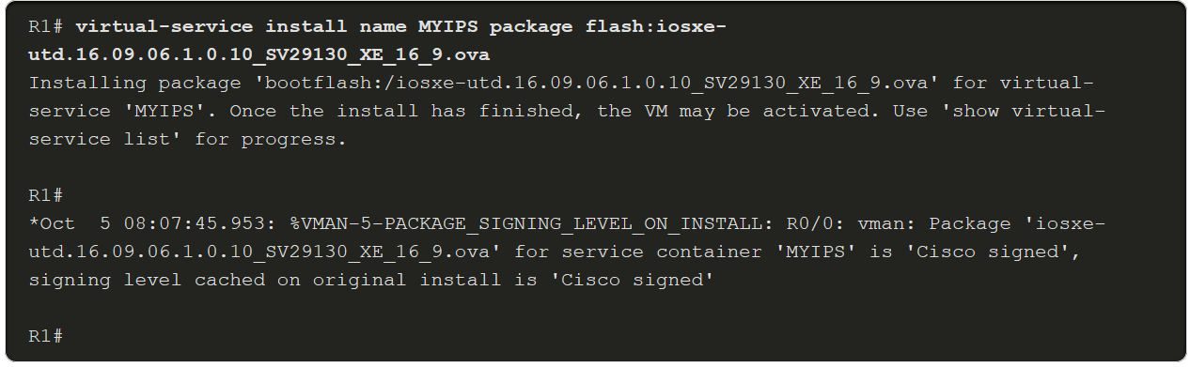
Configure Snort IPS
Step 2. Install the Snort OVA File
The OVA file must be downloaded and saved in a file location available to the ISR router (e.g., Flash).
To install, the OVA file, use the virtual-service install name virtual-service-name package file-url media file-system privilege EXEC command to install the OVA file to the router. The length of the name is 20 characters and the complete path to the OVA file must be specified.
An example configuration is shown below.
Use the show virtual-service list command to display the status of the installation of all applications installed on the virtual service container.
Notes:
12: IPS Operation and Implementation 12.3: Configure Snort IPS 12.3.3: Install the Snort OVA File

Slide 27
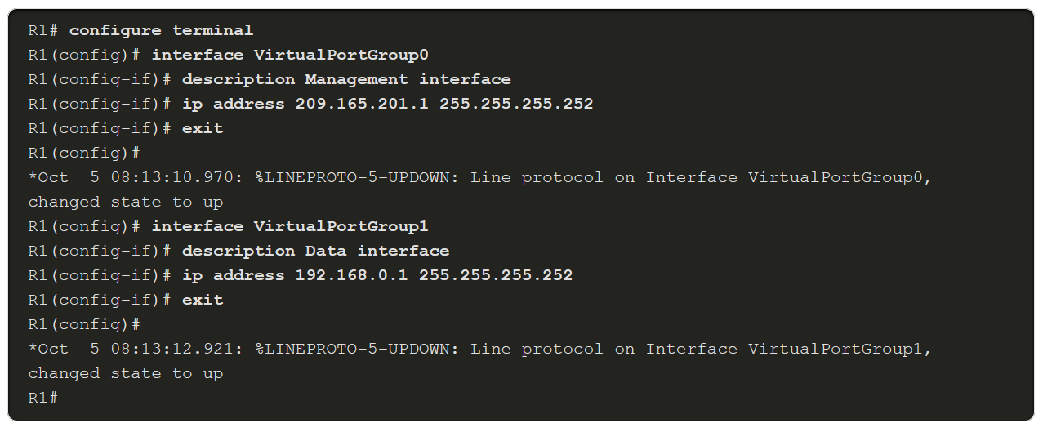
Configure Snort IPS
Step 3. Configure Virtual Port Group Interfaces
Two VirtualPortGroup (VPG) interfaces must then be configured along with their guest IP addresses.
In our example, the VPG interfaces will be configured as follows:
VGP0 - This is for management traffic to exchange information with IPS servers. The guest IP address needs to be routable to connect to the signature update server and external log server. It is also used to log traffic to log collectors.
VPG1 - This is for user traffic marked that should be inspected. This should not be routable and therefore use a non-routable private IP address.
This is a sample configuration of VPG0 and VPG1.
Notes:
12: IPS Operation and Implementation 12.3: Configure Snort IPS 12.3.4: Configure Virtual Port Group Interfaces

Slide 28
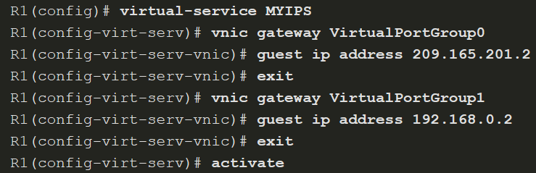
Configure Snort IPS
Step 4. Activate Virtual Services
The next step is to configure guest IPs on the same subnet for the container side and activate the virtual service.
The virtual-service MYIPS command configures the logical name that is used to identify the virtual container service.
The vnic gateway VirtualPortGroup interface-number command creates a virtual network interface card (vNIC) gateway interface for the virtual container service.
The guest ip address command configures a guest vNIC address for the vNIC gateway interface.
Finally, the activate command activates the application installed in a virtual container service.
Notes:
12: IPS Operation and Implementation 12.3: Configure Snort IPS 12.3.5: Activate Virtual Services

Slide 29
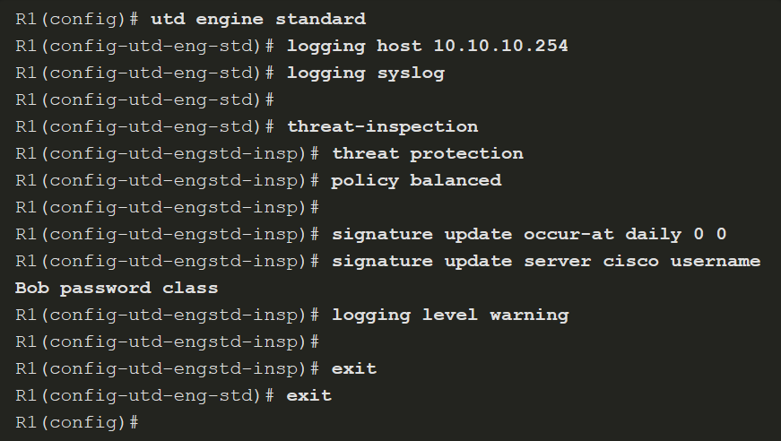
Configure Snort IPS
Step 5. Configure Snort Specifics
The utd engine standard command configures the united threat defense (UTD) standard engine and enters UTD standard engine configuration mode.
The logging host and logging syslog commands enable the logging of emergency messages to a server.
The threat-inspection command configures threat inspection for the Snort engine. From here you can specify which mode Snort will be in:
threat protection - Snort will be in IPS mode.
threat detection - Snort will be in IDS mode.
Notes:
12: IPS Operation and Implementation 12.3: Configure Snort IPS 12.3.6: Configure the Snort Specifics

Slide 30
Configure Snort IPS
Step 5. Configure Snort Specifics (Cont.)
The utd engine standard command configures the united threat defense (UTD) standard engine and enters UTD standard engine configuration mode.
The logging host and logging syslog commands enable the logging of emergency messages to a server.
The threat-inspection command configures threat inspection for the Snort engine. From here you can specify which mode Snort will be in:
threat protection - Snort will be in IPS mode.
threat detection - Snort will be in IDS mode.
Notes:
12: IPS Operation and Implementation 12.3: Configure Snort IPS 12.3.6: Configure the Snort Specifics

Slide 31
Configure Snort IPS
Step 5. Configure Snort Specifics (Cont.)
The policy command specifies three security policies that can be used by Snort. These are base policies provided by Cisco Talos. The three policy settings in order from least protection to most protection are:
connectivity - This provides the least protection as it prioritizes connectivity over security. Approximately 1,000 rules are pre-loaded using this policy.
balanced - This is the default policy. It is recommended for initial deployments. This policy attempts to balance security needs and performance characteristics of the network. Approximately 8,000 rules are pre-loaded using this policy.
security - This provides the most protection. It is designed for organizations that are exceptionally concerned about security. Customers deploy this policy in protected networks, that have a lower bandwidth requirements, but much higher security requirements. Approximately 12,000 rules are pre-loaded using this policy.
Notes:
12: IPS Operation and Implementation 12.3: Configure Snort IPS 12.3.6: Configure the Snort Specifics

Slide 32
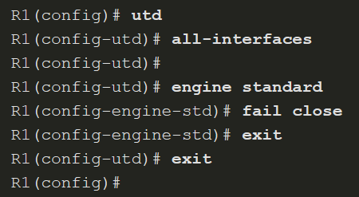
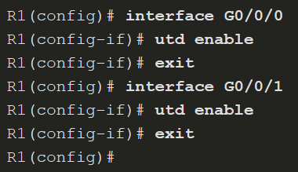
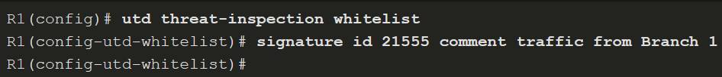
Configure Snort IPS
Step 6. Enable IPS Globally or on Desired Interfaces
Globally
Selected Interfaces
You can enable UTD globally on all interfaces or on selected interface.
You can also enable the UTD allowed list feature. This enables you to identify IPS signature IDs to be suppressed (not used)
Notes:
12: IPS Operation and Implementation 12.3: Configure Snort IPS 12.3.7: Enable Unified Threat Defense (UTD)

Slide 33
Configure Snort IPS
Step 7. Verify Snort IPS
After Snort IPS is implemented, it is necessary to verify the configuration to ensure correct operation.
There are several show commands that can be used to verify the Snort IPS configuration and operation.
show virtual-service list - The command displays an overview of resources that are utilized by the applications.
show virtual-service detail - The command displays a list of resources that are committed to a specified application, including attached devices.
show utd engine standard config - The command displays the UTD configuration.
show utd engine standard status - The command displays the status of the UTD engine.
show platform hardware qfp active feature utd stats - The command checks the data plane. It verifies increments for encap, decap, redirect, and reinject and displays a health of "Green".
Notes:
12: IPS Operation and Implementation 12.3: Configure Snort IPS 12.3.8: Verify Snort IPS
12.3.9: Syntax Checker - Configure Snort IPS
12.3.10: Check Your Understanding - Implementing Snort IPS

